Slide 1
IEEE – LEDS Project
Project Lead: Philip Wig
Slack: #ieee-leds

Slide 2
Use an SoC FPGA to drive LED panels with the goal of creating an LED Cube
Want to create a system to drive the LED panels to enable everything from animations to videos and even basic games
Getting familiar with everything from FPGA programming, hardware design, Linux programming and mechanical design

Slide 3

Has this been done before?

Slide 4
Linux on ARM CPU
Digital Logic in FPGA Fabric
Python or C++ code that creates animation or game or whatever you want
Framebuffer 0
Interface library and/or driver
PS-PL Bus
Display Driver
Converter
Display
Video file or other pre-rendered content
Framebuffer 1

Slide 5
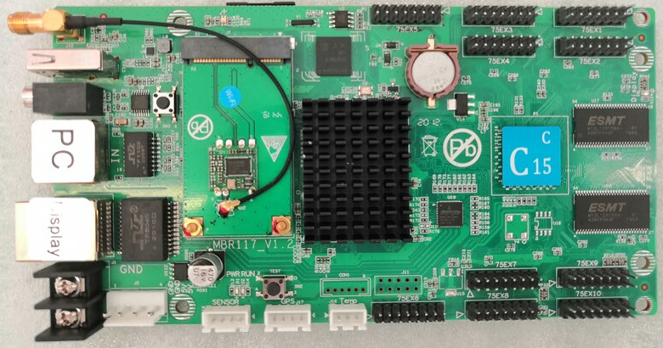
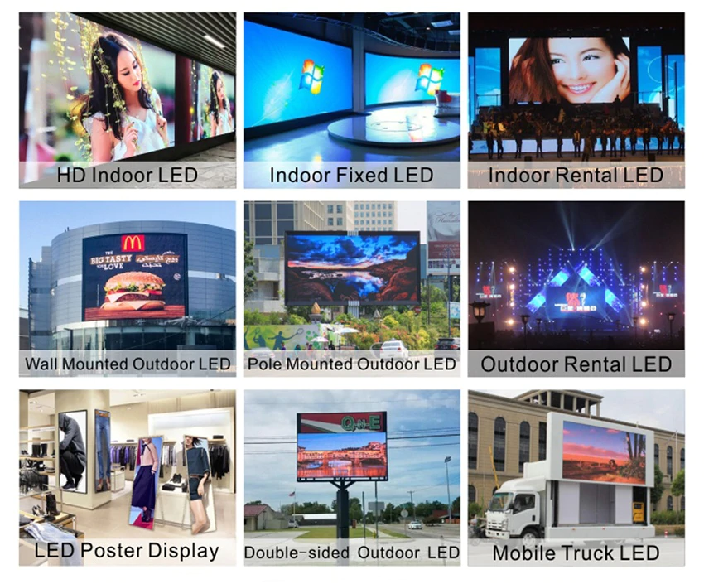
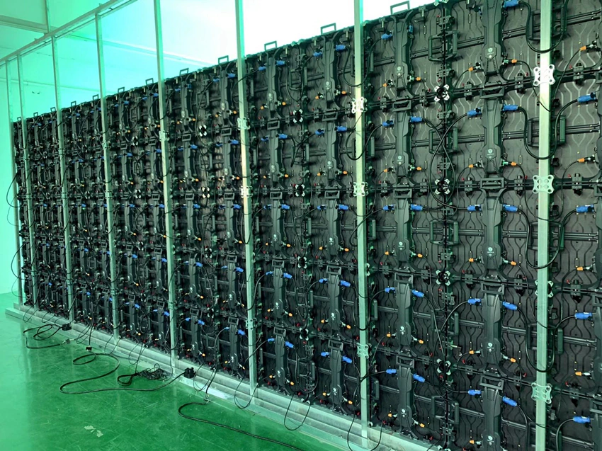
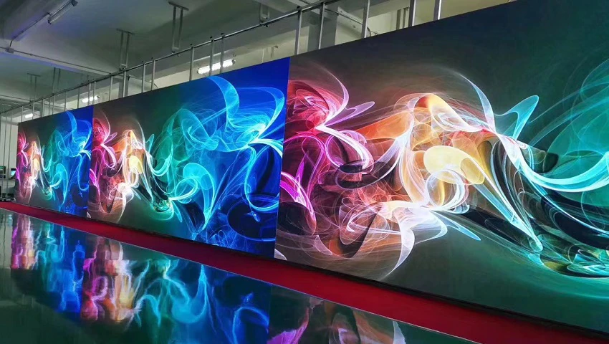
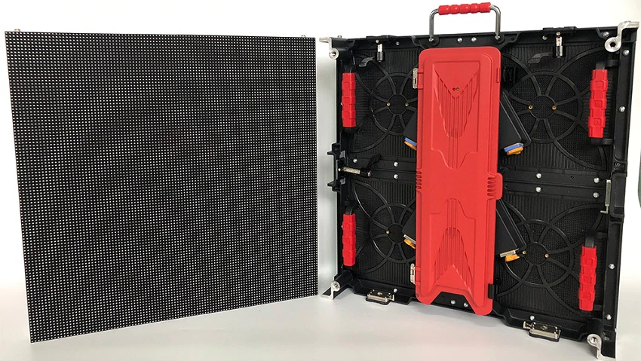
Examples

